Slide 1

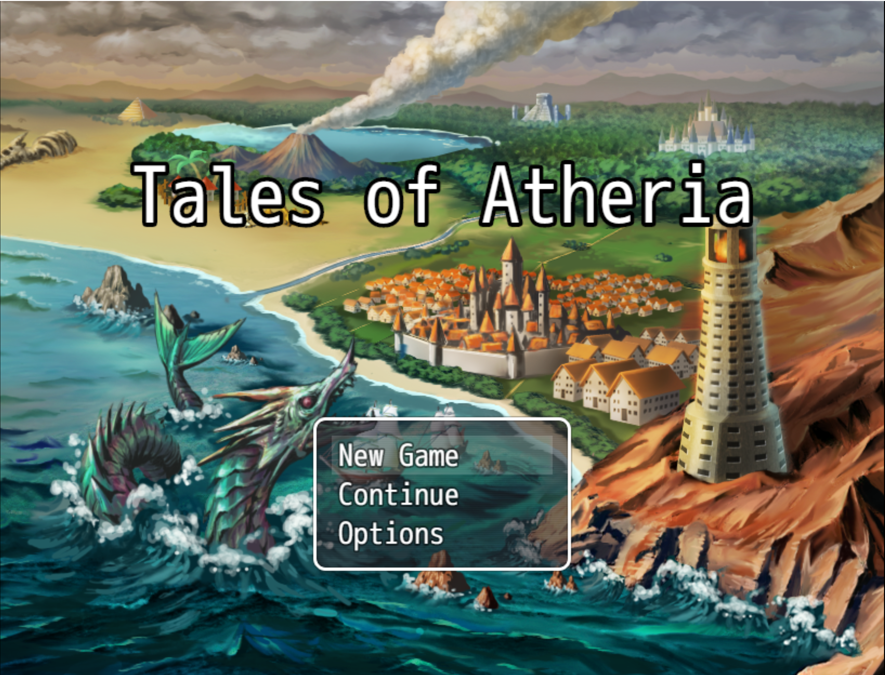
Tales of Atheria
Name: Karl Miller
Student No: x21522489
Course: BSHCSD4
Specialization: Software development

Slide 2
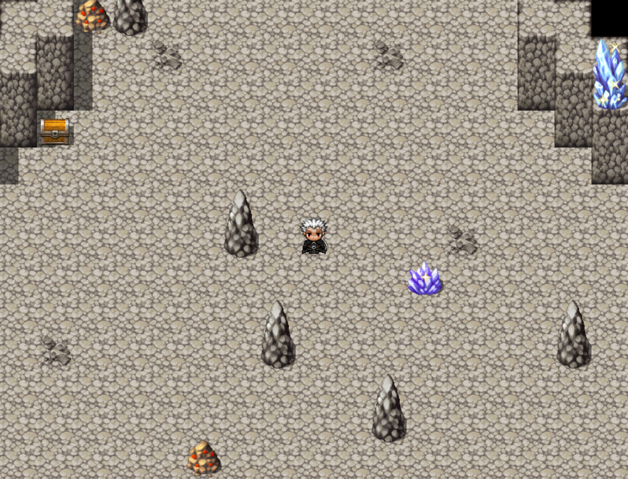
What is Tales of Atheria?
Tales of Atheria is a Rouge lite, resource gathering game with randomly generated resource nodes and enemy encounters.
The game is designed for those who enjoy collecting games like Stardew valley and Rouge lite games such as Slay the Spire.
What makes my game different? I've seen a lot of Rouge lites in my time as it's one my favorite game genres but very few I've played actively have the player collect resources to craft their own weapons and armor rather than finding loot from say chests.

Slide 3
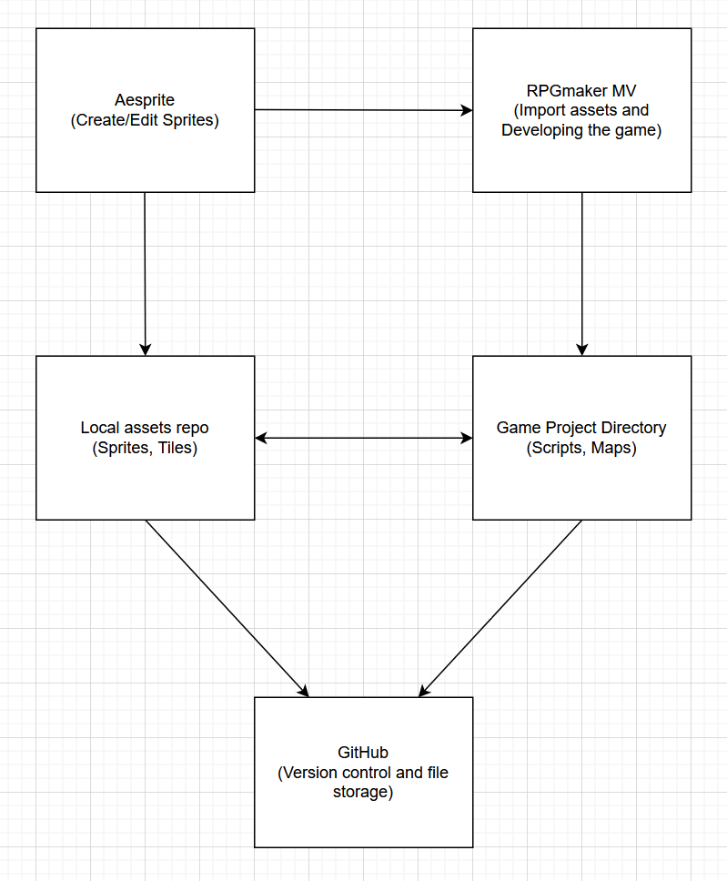
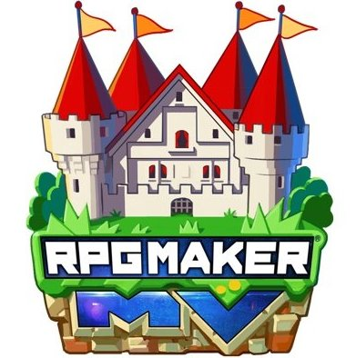


Technologies used
RPGmaker MV: Used for the development processes that make the game.
Aesprite: A Pixel art application used for Creating/Editing assets for the game's visuals.
GitHub: A cloud-based storage website that is used for version control and a safety net for the event of lost files

Slide 4
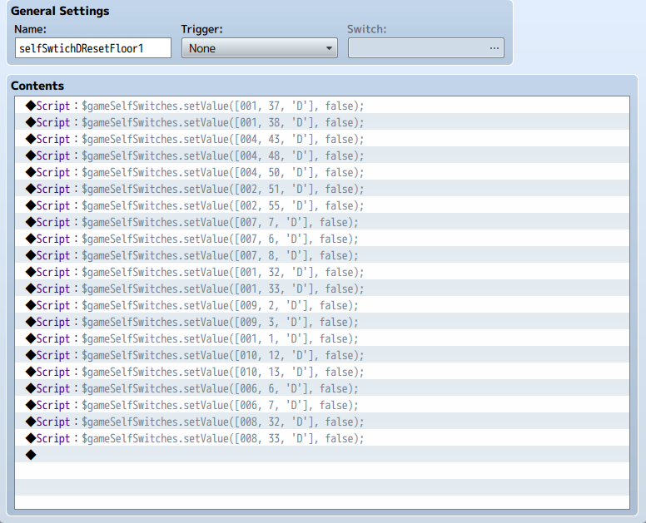
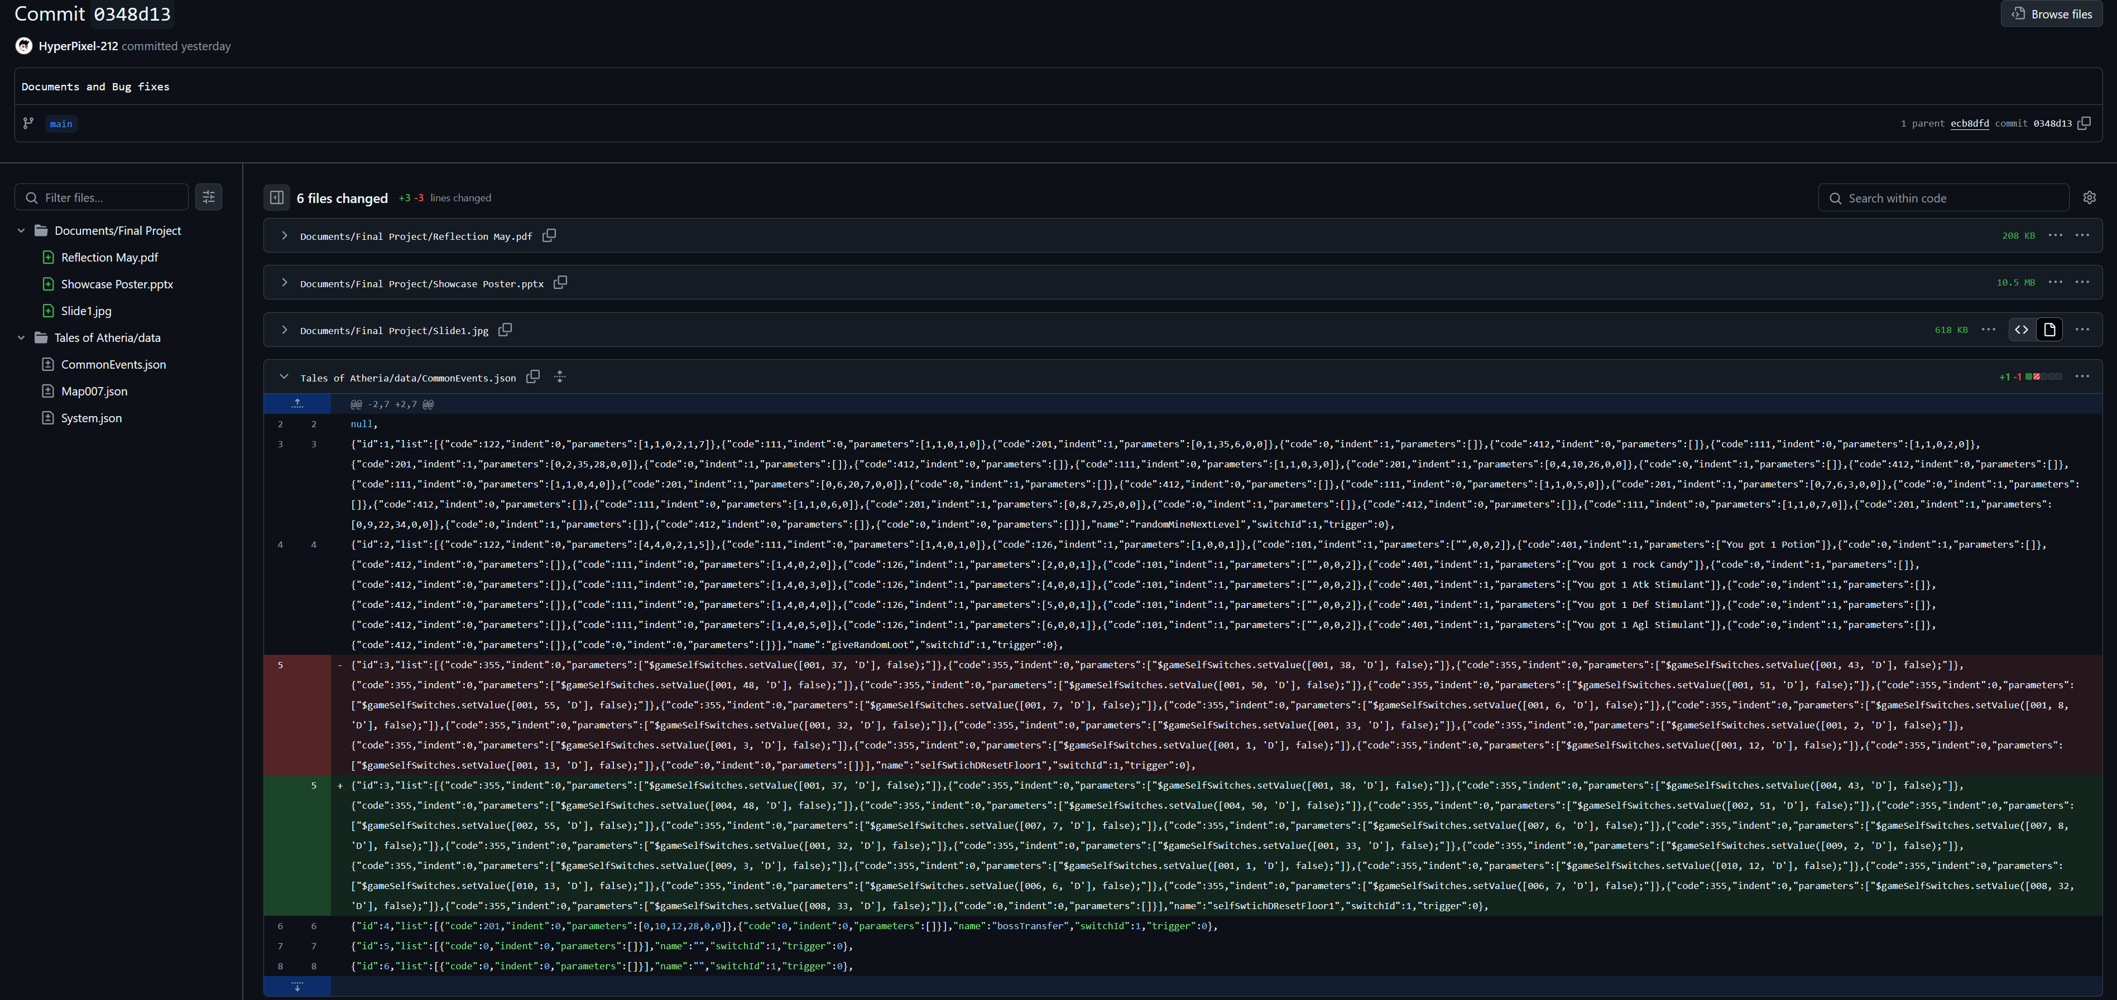
Testing
I did a Manual test recently on one of the most important aspects of the game which were the loot chests, I noticed they were not refreshing as they should be when transitioning through levels, so I was looking through my events and noticed there was an Issue on the chests

Slide 5

Transition
I will now be moving onto the demonstration of the game in action!

